Slide 1
Recommended Trees Species Palettes for the New Climate Paradigm
Jim Downer
University of California Cooperative Extension
Ventura County
ajdowner@ucanr.edu

Slide 2
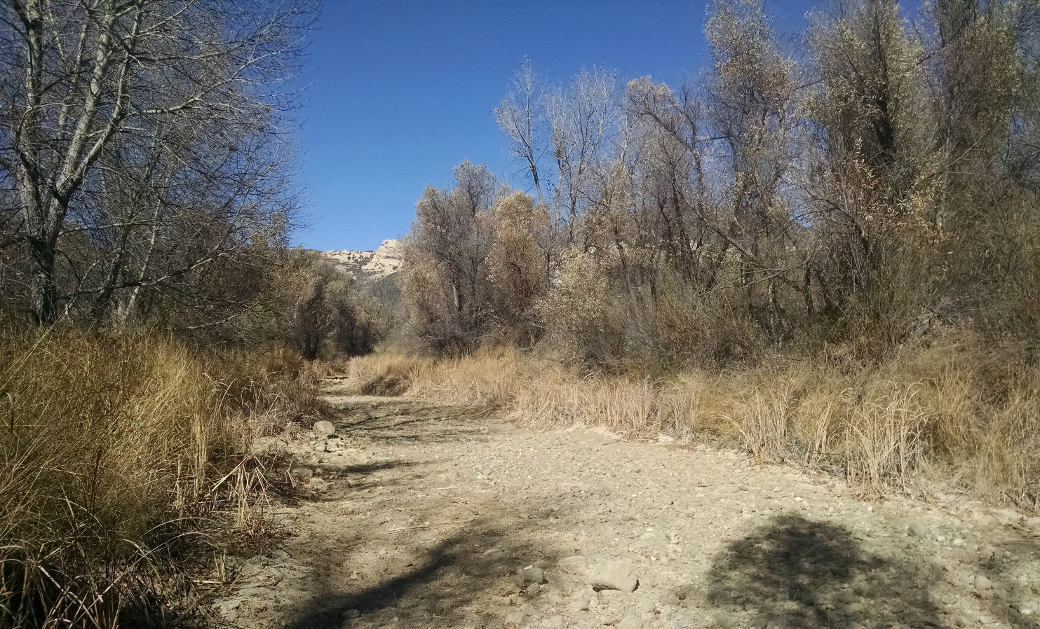
Drought
Sespe Creek, Lyons, Camp 2014 And in 2015!!!

Slide 3
Rainfall in Simi Valley

Slide 4
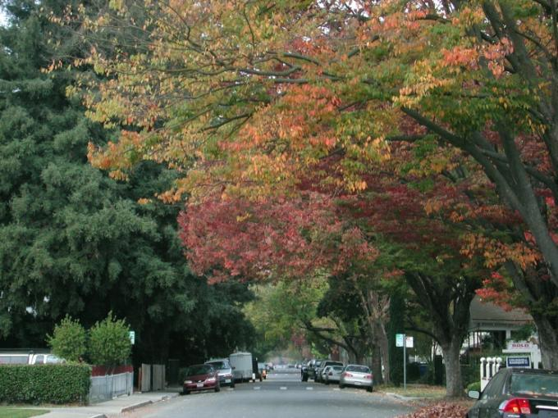
Climate Ready Tree Studies (MacPherson, Berry and others)
Stable, Healthy, Functional urban Forests
Notes:
Our long-term goal is to:
build and maintain a stable, healthy, and functional urban forest.

Slide 5
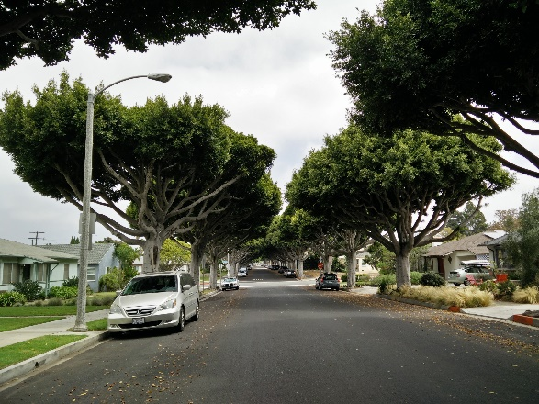
“Urban forestry is risk management”
Strategies to mitigate risk of loss
Increase diversity
Phase out poorly-adapted species
Which species are poorly adapted?
Notes:
Another way of thinking about it is that we’re managing for risk,
And our goal is to minimize the risk of tree loss. = CLICK=
To address this, we seek strategies that help:
minimize the risk of catastrophic losses and
maintain a continuous canopy cover.
One such strategy is to increase diversity,
whether it is in age, size, and/or species. =CLICK=
(E.g., the 10-20-30 rule for tree diversity (spp, genus, fam) aims to reduce the risk of catastrophic loss due to pests)
But it is more complicated than simply planting a diverse mix of tree species.
We need to know which species work and which ones won’t.
And that’s because what did well in the past might not do well in the future.

Slide 6
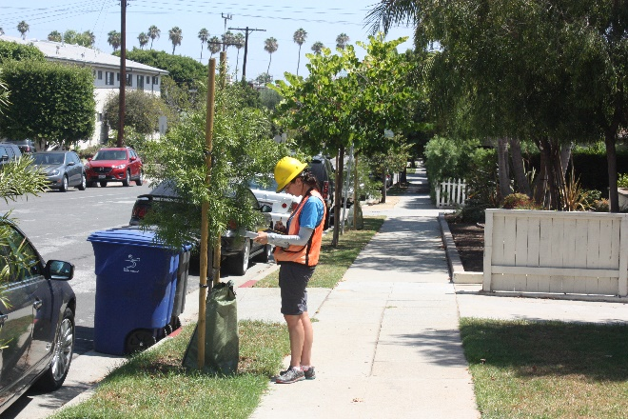
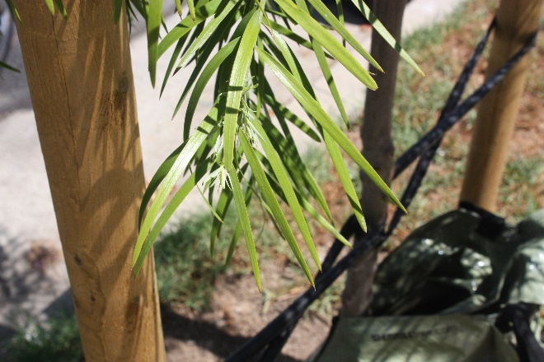
Primary points of leverage
Tree maintenance
Tree selection
Afrocarpus falcatus, African fern pine
in Santa Monica, CA
Notes:
We have two points of leverage:
For the trees already in the ground:
we maintain a healthy population that has the best chance of resisting pests/diseases or mechanical damage.
To maintain canopy cover:
we can make informed decisions on species selection – species that will be able to adapt to foreseeable changes in climate.
Two studies in particular paved the way for our project.

Slide 7
Climate models project major changes in climate zones, next 75 years
1. TEMPERATURE
 | Projected Changes in USDA Hardiness Zones
City | 2010-2019 Avg Min Temp (°F) | Current Hardiness Zone | 2080-2089 Avg Min Temp (°F) | Predicted Hardiness Zone
Redding | 34.1 | 9B ->10A | 40.6 | 10A-> 11A
Sacramento | 36.7 | 9B ->10B | 42.4 | 10B-> 11A
Merced | 33.6 | 9A ->10A | 38.9 | 10A-> 10B
Fresno | 34.6 | 9B ->10A | 40.0 | 10A-> 11A
Bakersfield | 36.3 | 9B ->10B | 41.5 | 10B-> 11A
For Inland Valley, model projects 1 ½ zone changes.
(less for coastal CA, Sierras)
32°F threshold: tree stress, pest populations; diseases.
2. PRECIPITATION
For Inland Valley
About 110% of current precipitation overall by 2090.
Generally: more winter precip, less summer.
pcm1
http://cal-adapt.org/tools/

Slide 8
GOALS OF THE PROJECT
A 20-year study to test tree species
for their qualities as urban trees, and
their potential resilience to anticipated climate change impacts, especially
seasonal drought,
higher temperatures – winter and summer-, and
increased pest and disease pressure.
Establish a network of experimental planting sites and local collaborators to evaluate the trees via repeated measurements.
Share information on their performance with arborists and urban foresters throughout the region.

Slide 9
Criteria for tree species selection
Currently not abundant already and not tested extensively in Inland Valley cities.
Proven successful in regions with similar climates, or somewhat warmer.
Planting stock currently available in nurseries.
Provide ample shade, need minimal care, have few problems.
A questionnaire was completed by experts to help identify promising tree species.

Slide 10
Species profiles were created using an expanded Tree Vulnerability matrix* to reveal biotic or abiotic problems.
*based on Pest Vulnerability Matrix, Laćan & McBride 2008
Notes:
We took the species that were suggested and scored them based on this Tree Vulnerability Matrix.
This matrix includes Drs. Lacan and McBride’s Pest Vulnerability Matrix but also considers:
the adaptation of species to local environmental conditions,
as well as tolerance to stress associated w/ climate change. = CLICK =
Specifically, we looked at Site-Habitat Specificity, Physiology, and Biological Interactions.

Slide 11
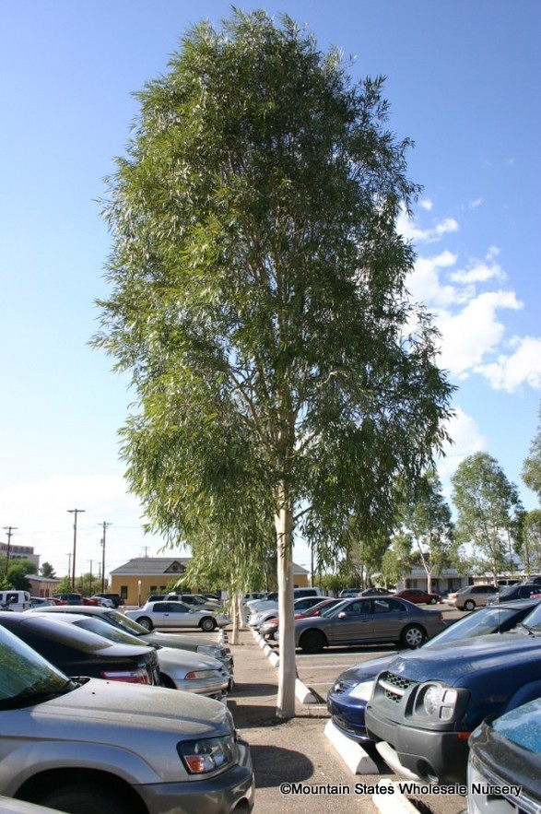
Risk Factor | Positive Vulnerability Score
HABITAT
Soil Moisture | (+) Species adapted to wet to dry soil.
Soil Texture and pH | (+1) Species tolerates all soil texture types and pH ranges: Soil Texture: Clay, Loam, Sand and Soil pH: Acidic, Neutral, Alkaline
Sunlight Exposure | (+1) Species is tolerant to sun, shade, and filtered exposure
Ghost gum (Eucalyptus papuana)
Notes:
So what gets a positive score?
We are looking for adaptability to the range of exposure trees may experience.
Species rank high if they can tolerate:
the range from wet to dry soil
all soil texture types and pH range;
and are tolerant to both sun and shade.
Ghost gum is a good example of a species that scored well in the habitat category.

Slide 12
12 tree species were selected For Coastal Southern California
.
Scientific Name | Common Name
Australia
Acacia aneura | Mulga
Corymbia papuana | Ghost Gum
Southwest US - drought tolerant
Acacia willardiana | Palo Blanco
Hesperocyparis forbesii | Tecate Cypress
Prunus ilicifolia ssp. Lyonii Quercus tomentella | Catalina Cherry Island oak
Oklahoma-Texas-Western US - deciduous
Celtis reticulata | Netleaf Hackberry
Prosopis galndulosa ‘Maverick’ | Maverick Mesquite
Quercus fusiformis | Escarpment Live Oak
Asia/South America
Dalbergia sissoo | Rosewood
Cedrela fissilis | Brazilian Cedarwood
Other
Pistacia ‘Red Push’ | Red Push Pistache

Slide 13
12 tree species were selected For Inland Southern California
.
Scientific Name | Common Name
Australia
Acacia aneura | Mulga
Corymbia papuana | Ghost Gum
Southwest US - drought tolerant
Acacia willardiana | Palo Blanco
Hesperocyparis forbesii | Tecate Cypress
Chilopsis linearis ‘Bubba’ Quercus tomentella | Desert Willow* Island oak
Oklahoma-Texas-Western US - deciduous
Celtis reticulata | Netleaf Hackberry
Prosopis galndulosa ‘Maverick’ | Maverick Mesquite
Quercus fusiformis | Escarpment Live Oak
Asia/South America
Dalbergia sissoo | Rosewood
Other
Pistacia ‘Red Push’ | Red Push Pistache
Parkinsonia x ‘Desert Museum’ | Desert Museum Palo Verde*

Slide 14
Acacia pendula Handroanthus heptaphyllus
Acacia xanthophloea Harpephyllum caffrum
Afrocarpus falcatus Juniperus chinensis 'Torulosa'
Alectryon excelsus Melaleuca decora
Angophora costata Melaleuca styphelioides
Angophora costata Parkinsonia florida
Banksia integrifolia Peltophorum dubium
Caesalpinia ferrea Pinus roxburghii
Callistemon salignus Pistacia 'Red Push'
Cordia boissieri Prosopis glandulosa
Corymbia papuana Prunus lyonothamnus ssp. asplenifolius
Corymbia torelliana Quercus viginiana var. fusiformis
Cupressus funebris Quercus polymorpha
Dalbergia sissoo Quercus rhysophylla
Ebenopsis ebano Quercus sartori
Elaeocarpus sylvestris Quercus tomentella
Eriobotrya 'Coppertone' Quercus hypoleucoides
Eucalyptus leucoxylon Sapindus saponaria
Eucalyptus melliodora Sophora secundiflora
Eucalyptus spathulata Taxodium mucronatum
Eucalyptus torquata Taxodium huegelii
Ficus rubiginosa Tecoma stans
Ficus rubiginosa ‘El Toro’ Ulmus crassifolia
Ficus sur Xylosma congesta

Slide 15
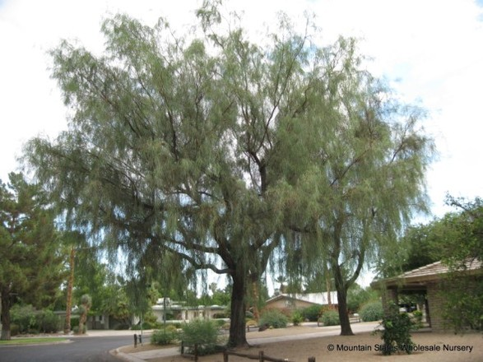
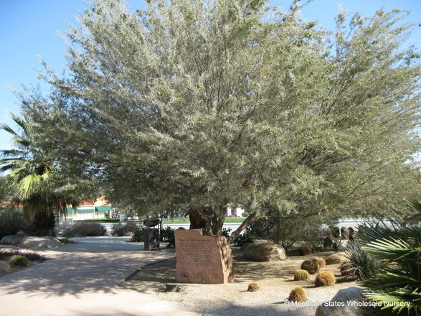
AUSTRALIA, DROUGHT TOLERANT
Shoestring acacia (Acacia stenophylla)
Mulga
Ghost gum (Eucalyptus papuana), 60’ height
Mulga (Acacia aneura)

Slide 16
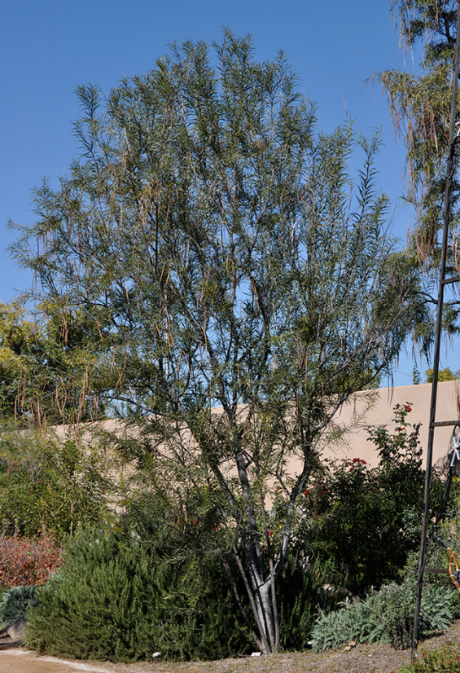
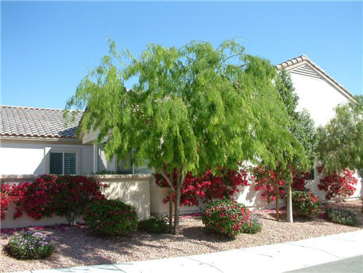
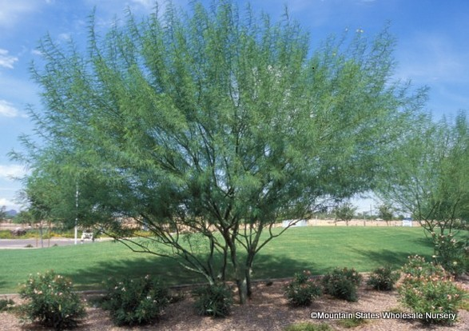
SOUTHWEST US,
HIGHLY DROUGHT TOLERANT
Smaller stature (15’-35’), few pests
SelecTree
Desert willow (Chilopsis linearis)
Honey Mesquite
(Prosopis glandulosa x 'Maverick’)
Palo Verde “Desert Museum”

Slide 17
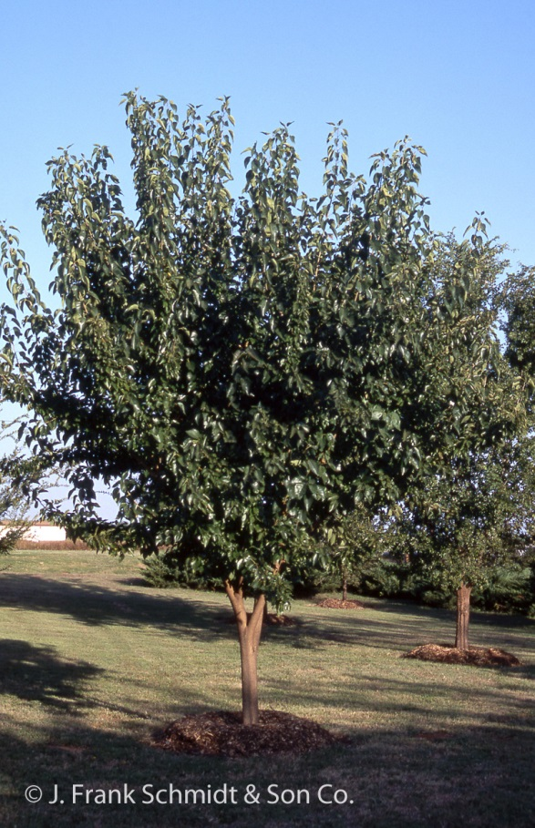
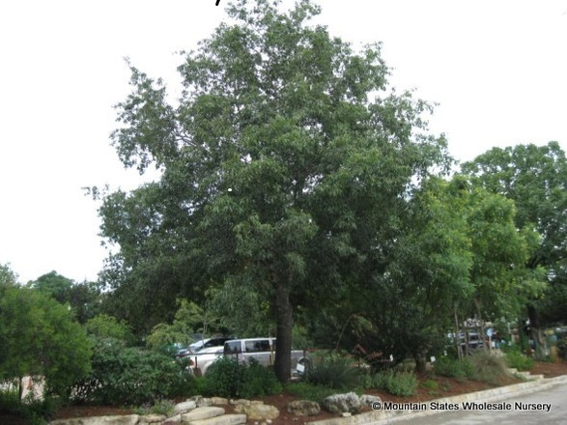
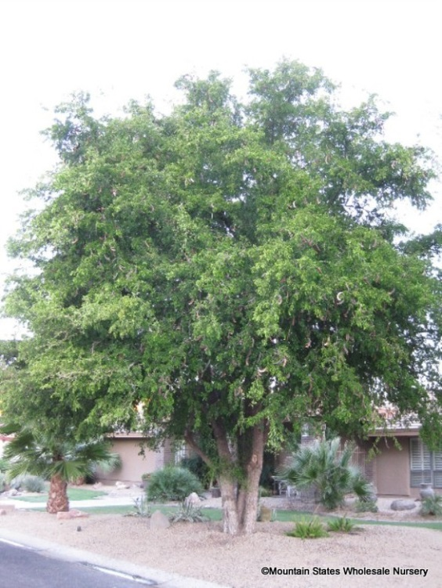
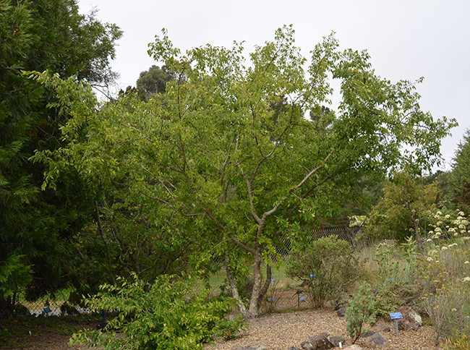
Canby Oak – up to 50’
Osage Orange 30’-50’
Texas Ebony
(thorns, borer)
OKLAHOMA-TEXAS-WESTERN US
Deciduous or evergreen-deciduous trees, depending on temperature; generally few pests.
SelecTree
Netleaf Hackberry - up to 80’

Slide 18
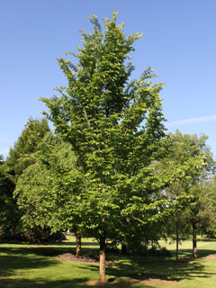
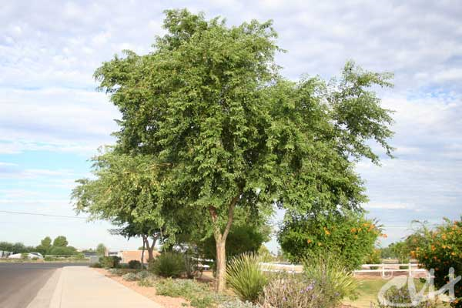
ASIA
Rosewood
(Dalbergia sissoo; India)
Elm ‘Emerald Sunshine’
Ulmus davidiana v japonica
60’, full leafy crown, highly decay resistant, few pests (root suckers)
35’; DED, elm leaf beetle resistance

Slide 19
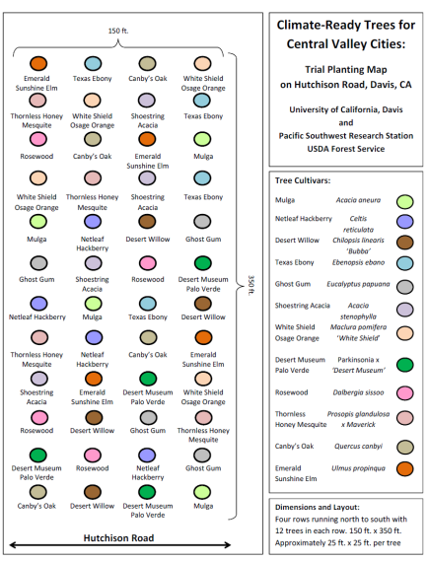
EXPERIMENTAL DESIGN
City of Sacramento, Parks & Public Works Departments
96 trees total were planted, in 4 parks (24 each).
Parks: a range of planting situations and irrigation: bare ground, drip irrigation, turf with sprinkler, fescue with bubblers.
Sacramento Tree Foundation organized volunteers, plus great efforts by City personnel.
Control Plot at UC Davis, 48 trees total were planted (4 each, per 12 species)
UCD Grounds Division volunteers, plus Plant Sciences staff .

Slide 20
Trees failing in irrigation restricted landscapes
Ventura County Master Gardener Survey, 2016

Slide 21
Trees Thriving in irrigation restricted landscapes
Ventura County Master Gardener Survey, 2016

Slide 22
Problems with the MG (“Citizen Science”) survey method
Even among MG volunteers there are not enough volunteers who can accurately identify trees in the field
Multiple observers have multiple methodologies for applying a rating scale
Applying two rating scales at the same time doubles the potential error of collected results
Therefore we decided to conduct surveys with just ourselves collecting the data from randomly selected N/S streets in three cities across an ET gradient in Southern California.

Slide 23
Surveys: What is happening—In different areas of the southland?
ET is on a variable gradient from the coast into the inland empire
Our surveys looked at front yards on N/S streets and made an estimation of water application as well as tree species presence and performance

Slide 24
Visual Drought rating
Wet = Landscape is lush: Turfgrass if present is uniformly green, all plantings show good growth no indications of foliage stress
Medium = Acceptable landscape quality: Turfgrass if present, is mostly green but with brown areas showing lack of irrigation, some browning of foliage or other stress signs.
Medium/Low = Barely acceptable landscape quality: Turfgrass if present, is brown in many places but still with an underlying green, shrubs and other plantings all showing stress.
Low= Turfgrass has died out in many places and only remains in patches or edges and appears stressed. Dead plants are present in landscape and all other plants show stress.
V Low = All plants including turfgrass are dead. Bare dirt is the prevalent condition. The only surviving plant is the tree being evaluated.

Slide 25
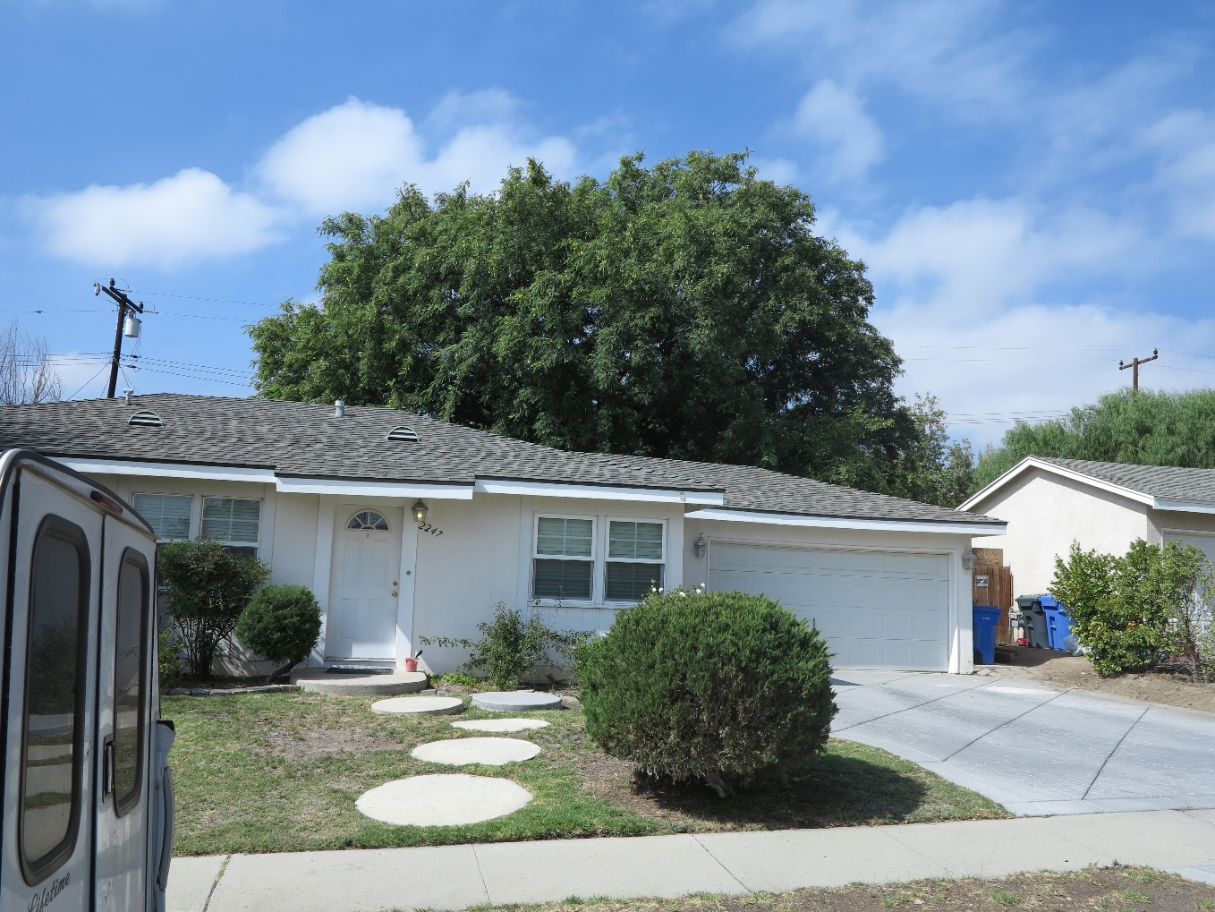
Landscapes
High Medium

Slide 26
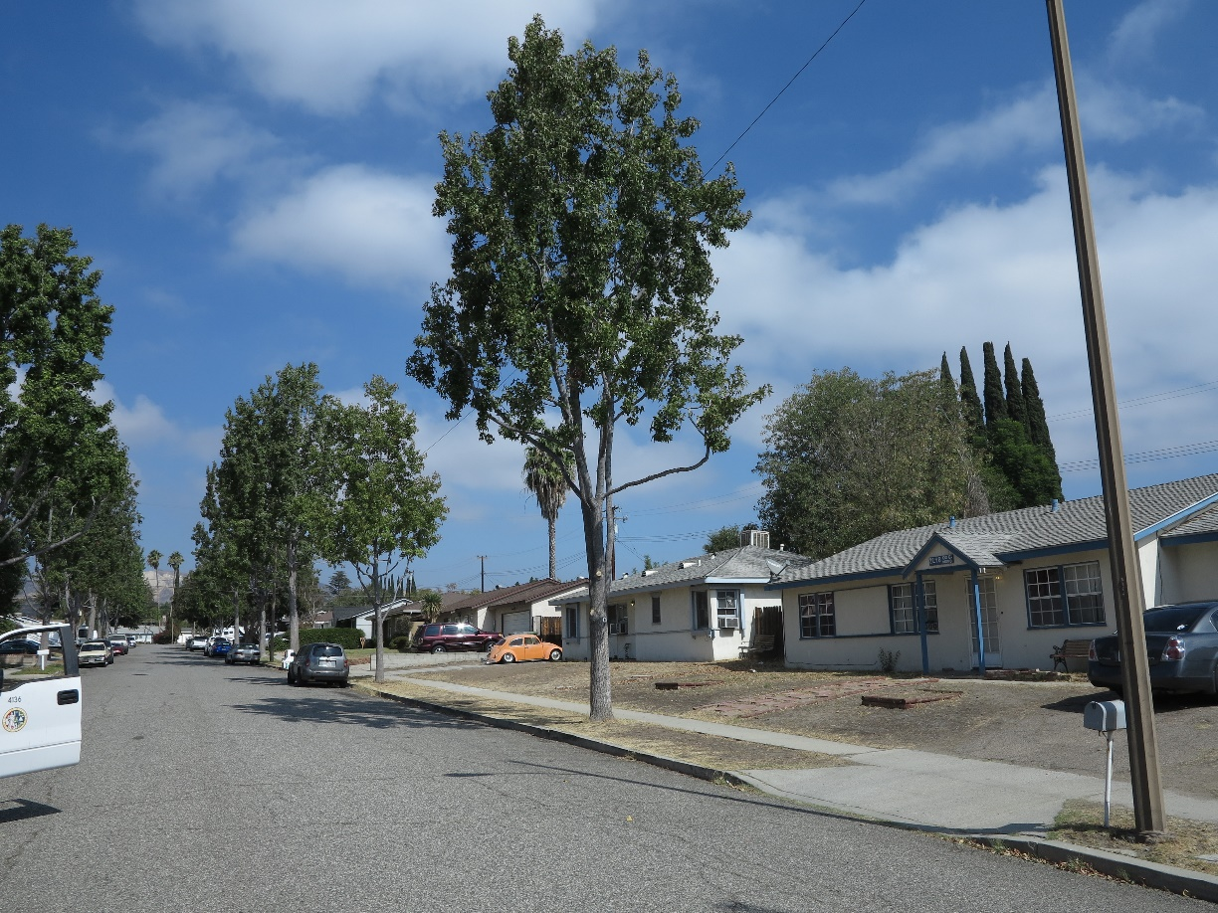
Landscapes
Low Very Low

Slide 27
Frequency distribution of trees taxa in Ventura survey.

Slide 28
Drought and root disease look similar

Slide 29
Species Profile Camphor: Cinnamomum camphora
Quality ratings
Wet | Medium | Low-Medium | Dry | Very Dry
4.9 | 3.9 | 3.8 | 2.9 | --
n=41, Ventura CA

Slide 30
Species Profile Pygmy Date Palm: Phoenix roebellini
Quality ratings: Ventura
Wet | Medium | Low-Medium | Dry | Very Dry
5 | 4.06 | 3.7 | 3.2 | --
n=41, Ventura CA
Quality ratings: Simi Valley
Wet | Medium | Low-Medium | Dry | Very Dry
4.5 | 4.0 |  | 2.6 | --

Slide 31
Species Profile Queen Palm: Syagrus romanozoffianum
Quality ratings: Ventura
Wet | Medium | Low-Medium | Dry | Very Dry
4.5 | 4 |  | 3.2 | --
n=41, Ventura CA
Quality ratings: Simi Valley
Wet | Medium | Low-Medium | Dry | Very Dry
 | 3.4 |  | 2.7 | --

Slide 32
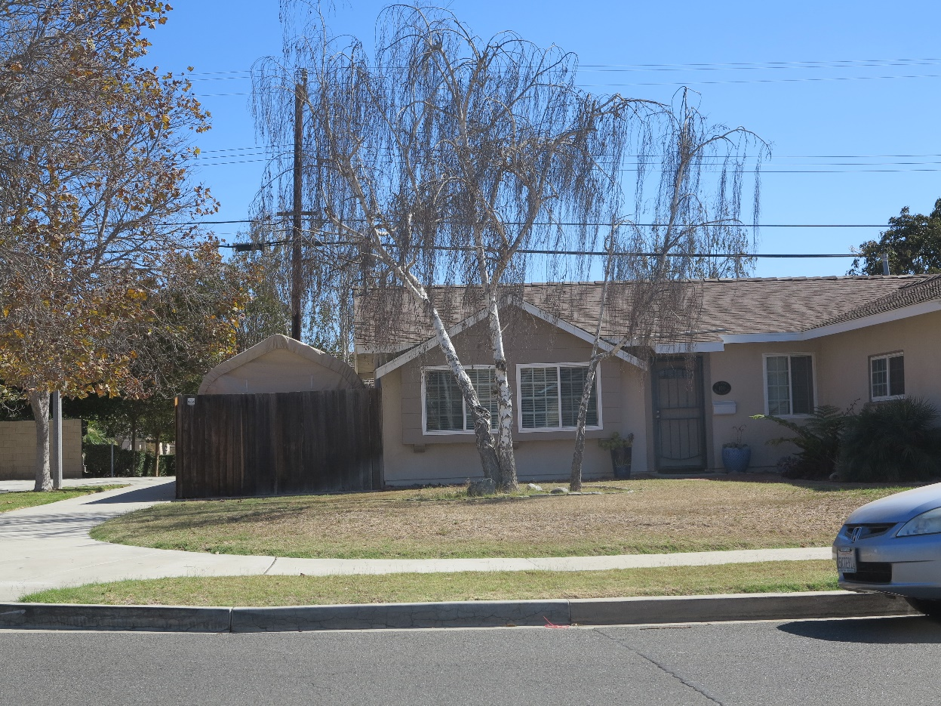
Species Profile European Birch: Betula pendula
Quality ratings: Ventura
Wet | Medium | Low-Medium | Dry | Very Dry
4 | 3.2 | 2 | 1.8 | --
n=41, Ventura CA
Quality ratings: Simi Valley
Wet | Medium | Low-Medium | Dry | Very Dry
3.3 | 2.5 |  | 1 | 1

Slide 33
Species Profile Chinese Pistache: Pistacia chinensis
Quality ratings: Simi Valley
Wet | Medium | Low-Medium | Dry | Very Dry
5 | 4.6 |  | 3.9 | 3.2

Slide 34
Species Profile Holly Oak: Quercus ilex
Quality ratings: Simi Valley
Wet | Medium | Low-Medium | Dry | Very Dry
5 | 4.7 |  | 3.9 | 3.3

Slide 35
Species Profile:Golden Rain Tree: Koelreuteria paniculata
Quality ratings: Simi Valley
Wet | Medium |  | Low-Medium | Dry | Very Dry
 | 3.8 |  | 3.3 | 2.8

Slide 36
Species Profile Crape Myrtle: Lagerstroemia indica
Quality ratings: Simi Valley
Wet | Medium | Low-Medium | Dry | Very Dry
3.5 | 4 |  | 2.6 | 2.8

Slide 37
Spurious observations
Schinus mole are very drought tolerant
Pines, Redwoods, Some Eucalyptus and even coast live oak are dying out in some places in Southern California
Should we plant very drought tolerant trees if they are considered “invasive”

Slide 38
Between Species/Within Species effects
Some eucs benefit from drought some do not (Corymbia citriodora in Ventura linear park strip)
Pines: are all pines suffering equally?

Slide 39
Heat Tolerance
Heat tolerance is not drought tolerance
Although they may go together in some species.
Recent high temperature effects show us that even drought tolerant species are subject to heat damage

Slide 40
Resource limitations
If water resources are limiting, do we want larger trees in future landscapes? Can we afford the water use?
If irrigation of non-perennial plantings (turfgrass and groundcovers) is restricted will larger trees survive the urban environment?
Climate ready or not…. Trees will fail
Coast redwood at Lake Casitas

Slide 41
Maintenance of climate ready trees
Establishment (minor inputs of:)
Irrigation
Pest Managment
Pruning
Maintenance
No applied water, Minimal Pruning, No pests, Stabile architecture that provides all the benefits of shade trees in an urban setting

